Slide 1

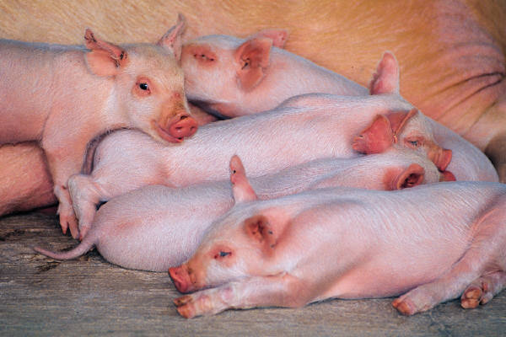
Agricultural Homesteads
A basic overview
MAAO 2014 Summer Seminars

Slide 2

Basic set of rules.
Must be the owner or a qualifying relative
Must occupy the property as their primary residence
Must be a Minnesota residence (important for relative homestead)

Slide 3
Indicators to help determine primary residency
Where is the taxpayer registered to vote
Where is their mail delivered to
Does the taxpayer own another property
Has the taxpayer applied for and/or received rent credits
What address does the driver license show
Do they pay non-residence fees for hunting or fishing license

Slide 4

General Rules
Can claim only one homestead
Full homestead – own and occupy by Jan 2
Mid-year homestead – own and occupy after Jan 2 but before Dec 1st (if purchased non-homesteaded property)
With a few exceptions need only apply once

Slide 5
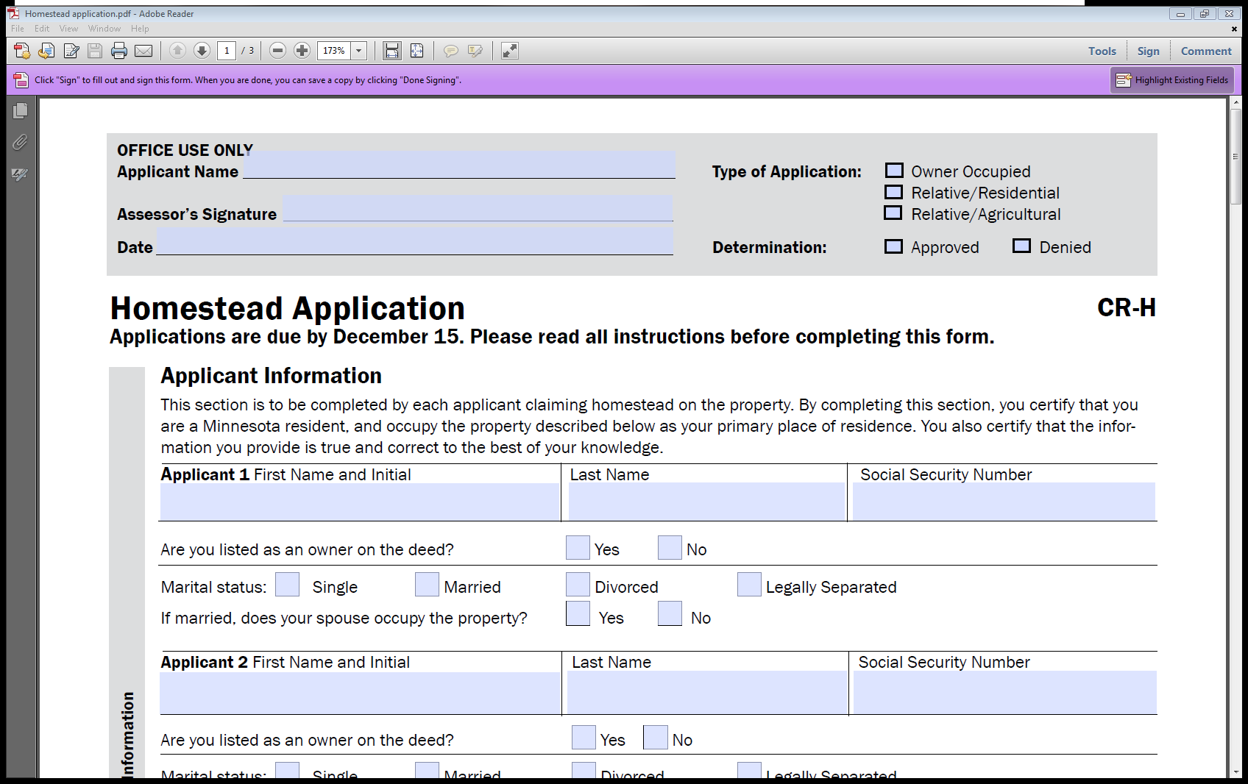
Notes:
What needs to be filled out on form. Separate form for relative.

Slide 6

Agricultural Homesteads

Slide 7
Qualifications to be Agricultural
At least 10 contiguous acres used to produce agricultural products (or qualifying land in an eligible conservation program)
Agricultural products defined by statute
The agricultural products must be for sale
  Livestock, dairy animals/products, poultry, fur-bearing animals, nursery, fruit and vegetables
  Fish bred for sale and consumption
  Game birds and waterfowl
  Insects that are primary bred to be used as food for animals

Slide 8
Homestead rules that only apply to Agricultural Properties
Property can be in a corporation, limited liability company, limited partnership, trust, or joint family farm venture
  Must be registered as a family farm with the Minnesota Department of Agricultural
  Can have multiple residences within the entities and receive homestead as long as they are a member, partner or shareholder
  Can not link different entities for homesteading
  273.124 subd. 8

Slide 9


Additional land does not have to be contiguous to the property where the agricultural homestead residence is but still must meet the agricultural definition
  Noncontiguous land can be homesteaded up to four cities or townships or combination thereof away and can cross county lines

Slide 10
Relative Agricultural Homestead
Owner must be a Minnesota Resident
Only son, daughter, brother, sister, grandson, granddaughter, father, or mother of the owner or the spouse
Neither the owner or the spouse receives another agricultural homestead in Minnesota
Owner is limited to only one agricultural relative homestead

Slide 11
Agricultural relative homesteads extends the homestead benefits to all land under the owner’s name.
If grandparents, aunts, uncles, nieces or nephews of the owner or spouse occupy the residence can receive relative homestead on the house/garage and one acre but not the land – here the owner does not need to be a Minnesota resident
Notes:
A corporation or LLC cannot receive a relative homestead

Slide 12
History of Special Ag Homesteads
1998 – Southwest Minnesota was hit with an outbreak of tornadoes
7 counties were included in the law that allowed people to retain the agricultural homestead on farms that building site was abandoned due to the tornadoes as long as the owner lived with 50 miles.
1999 – law was changed to include the whole state

Slide 13
Special Agricultural Homestead
The owner of the farm land no longer occupies the resident but still participates in the day to day responsibility of the farming operation
  Owner must live within four townships or cities
  Owner must actively farm the land
  Owner must be a Minnesota resident
  Owner nor their spouse claim another agricultural homestead
  Farm consists of at least 40 contiguous acres

Slide 14
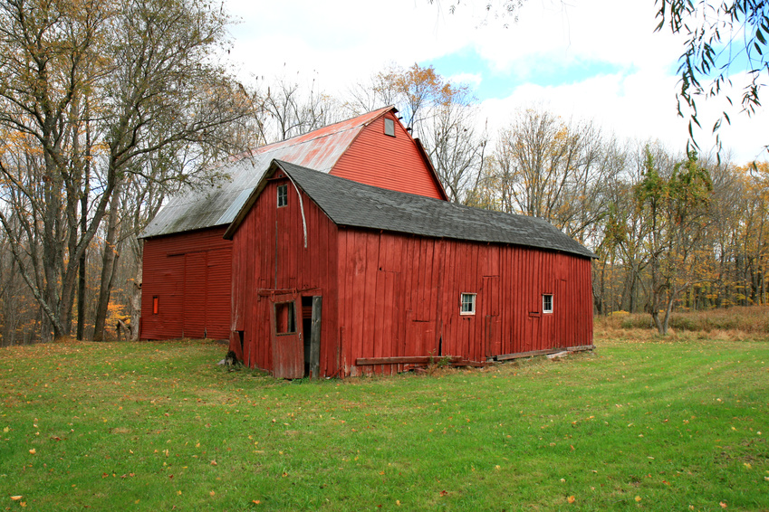
Special Agricultural Homestead
2000 – law was expanded
  Son or daughter of the owner
  It also allowed ownership by an authorized entity to receive homestead if a member of the entity farmed the land

Slide 15
Special Agricultural Homestead
2001 – law was expanded again
  Son or daughter of the owner to farm on the owners behalf or for the authorized entity
  It allowed for the extension of the four townships or cities if the owner’s job required they live further away and the employer provided housing
  Now includes property in a trust
  It now allows authorized entity to lease land from a member of the entity

Slide 16
Special Agricultural Homestead
2005 – law changed again
  Expands relative to grandchild of the owner or of the trusts
2008
  Expands relative to include brother and sisters
  Except in a trust, entity owned property
  cannot received an agricultural relative
  homestead

Slide 17
Special Agricultural Homestead
Over 50% Rule
  The parcel must be at least 40 contiguous acres
  There must be enough of an agricultural use (10 acres) to sustain the ag class
  Consider how much land is farmed by the person receiving homestead
      This is for properties where the owner may only farm part of his land and rents part of it out

Slide 18
Special Ag Application
Filing Requirements
This is a yearly application with forms being sent out in the fall
Due date to receive forms back is December 15th
There are 13 different forms to cover all types of special ag ownership options
Must provide the Schedule F, 156 EZ form and FSA number
Notes:
Cannot abate – if miss deadline than has to wait till the next year

Slide 19
Why does everyone want AG?
Class | Description | Net Tax Capacity (NTC) Class Rate
2a | Agricultural Homestead House, Garage, One Acre: first $500,000 over $500,000 Remainder of Farm: first $1,900,000 over $1,900,000 | 1.00% 1.25% 0.50% 1.00%

Slide 20
History of the Ag Tier Limit
Assessment Year | ​Valuation Limit
​2006 | ​$690,000
​2007 | ​$790,000
​2008 | ​$890,000
​2009 | ​$1,010,000
​2010 | ​$1,140,000
​2011 | ​$1,210,000
2012 | $1,290,000
2013​ | $1,500,000​
2014​ | $1,900,000​

Slide 21
How the Ag Tier is determined
The Department of Revenue calculates and certifies the first-tier valuation limit rounded to the nearest $10,000. Assessment data is used to calculate the new limit, which is the product of:
the first-tier limit for the preceding assessment year, and
the ratio of the statewide average taxable market value of agricultural property per acre in the preceding assessment year to that of the second preceding assessment year.

